Slide 1
Performance Estimation, Testing, and Control of Cyber-Physical Systems Employing Non-Ideal Communications Networks
Richard Candell
PhD Thesis
July 3, 2020

Slide 2
About Me

Slide 3
CPS Necessities
The automation system must become state aware and adaptive to knowledge of the trends in electromagnetic spectrum occupancy and acute events;
Intelligence of the automation system must move closer to the physical system. This means moving the intelligence for control to the actuator; and
Performance test methods must be developed and incorporated into the industrial fringe devices. The test methods must be dependable and at the same time easy to use by factory personal not trained in the technicalities of wireless communication.
Existing Wireless communications protocols must be analyzed and adapted, and new protocols must be developed to balance reliability, latency, and scalability.
Security of the network must be maintained and must include availability as a paramount characteristic.

Slide 4
Thesis Motivation
The primary motivation of the research has been to discover practical test and evaluation methods for assessing performance of an industrial workcell thereby improving security, safety, and reliability.

Slide 5
Thesis Goals
Thus the primary goal of this thesis is the discovery of methods and approaches to the evaluation of industrial uses cases performance for those use case in which wireless communication technology is used as the principal mode of communications.

Slide 6
Contributions
\item[Requirements] \cite{CandellRW2017} \cite{Montgomery2019} \cite{Candell2018.IWSGuide} \cite{ieeeMagazine2018} An examination of the wireless technology landscape is conducted. Existing and future wireless technologies are assessed for their appropriate applicability to industrial use cases. In~\cite{Candell2018.IWSGuide}, the authors produced a major contribution for the manufacturing industry to effectively design and deploy \glspl{iwn} used for sensing, control, monitoring, and surveillance. In ~\cite{ieeeMagazine2018}, our guidelines are presented to the academic community as a peer-reviewed article.
\item[Modeling] \cite{Candell2019ASR.SYSML} \cite{Candell2018SysML.JRES} In an effort to better understand the architectural composition of the workcell using industrial wireless communication, modeling techniques are used to identify and decomposed the parts, interfaces, and data flows. SysML is adopted for this process and a proposed modeling library is created and presented. The model with conceptual diagram is made publicly available independent of the tool that was used to create the model.
\item[Application of Graph Database] \cite{CandellISIT2020.Conf} \cite{GraphDB.JCISE.Journal} A method is developed for collecting, cleaning, organizing, and presenting the cyber-physical performance indicators of experiments run within the \gls{nist} Industrial Wireless Testbed. The method developed utilizes the Neo4j \gls{gdb} and is presented as a novel approach as compared to traditional approaches using relational database, spreadsheets, and raw file processing.
\item[Machine Learning] \cite{CandellISIE2019.Conf} \cite{Candell2020.Jrnl.ISATrans} A machine learning technique is developed and applied to the prediction of \gls{sir} levels within a wireless factory workcell network employing a robot arm within a force-seeking apparatus. The machine learning method allows a trained network to accurately determine the \gls{sir} level using the physical state of the robot arm rather than the state of the wireless link itself.

Slide 7
Introduction to Smart Manufacturing and IIoT
Performance Estimation, Testing, and Control of Cyber-Physical Systems Employing Non-Ideal Communications Networks
Richard Candell

Slide 8
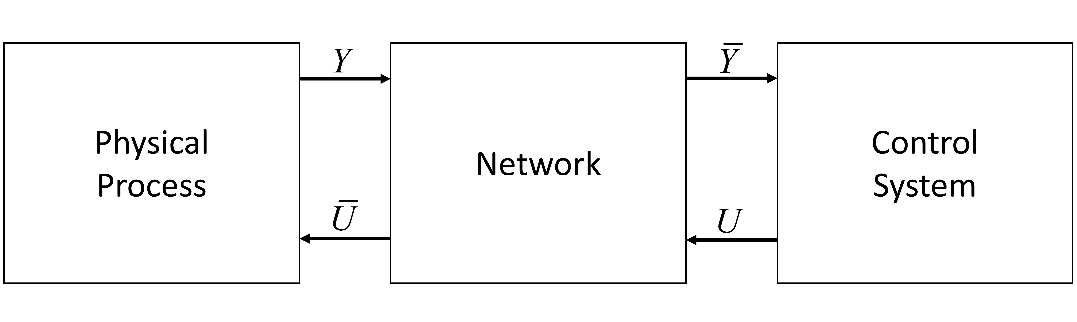
Model of a cyberphysical system

Slide 9
Industrial Wireless Technologies
Performance Estimation, Testing, and Control of Cyber-Physical Systems Employing Non-Ideal Communications Networks
Richard Candell

Slide 11
SysML: Workcell Architectural Decomposition and Analysis
Performance Estimation, Testing, and Control of Cyber-Physical Systems Employing Non-Ideal Communications Networks
Richard Candell

Slide 13
The NIST Industrial Wireless Testbed
Performance Estimation, Testing, and Control of Cyber-Physical Systems Employing Non-Ideal Communications Networks
Richard Candell

Slide 14
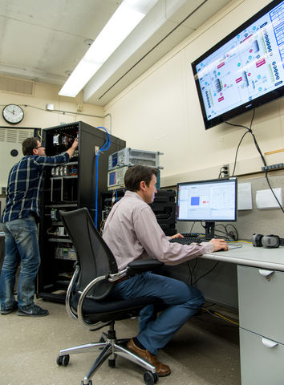
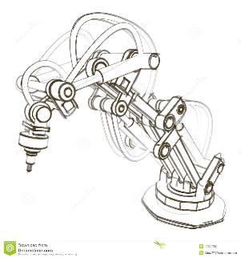
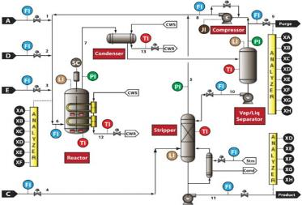
NIST Industrial Wireless Testbed
Process
Control
Discrete
Manufacturing
Past Focus
Current Focus
Slow Processes
e.g. “TESIM” Chemical Reactor
Discrete/Fast Processes
e.g. Mechanical Assembly

Slide 15
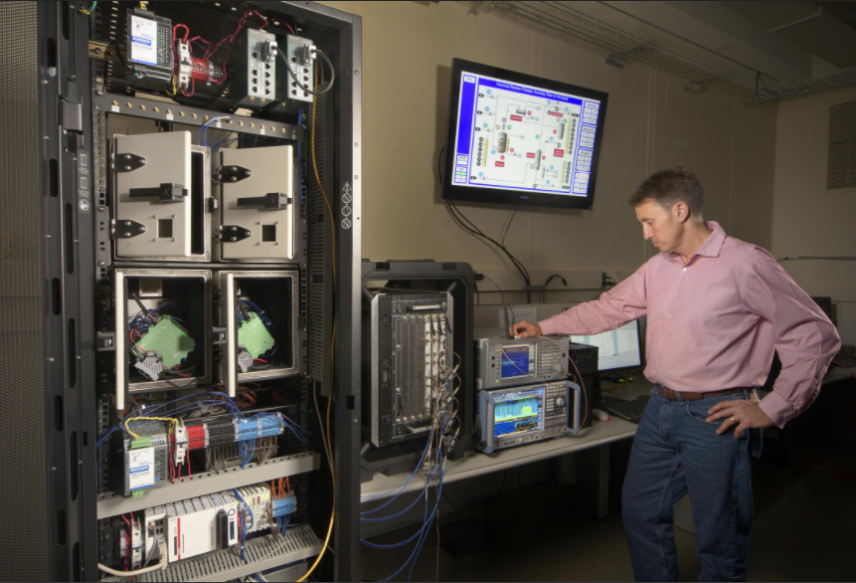
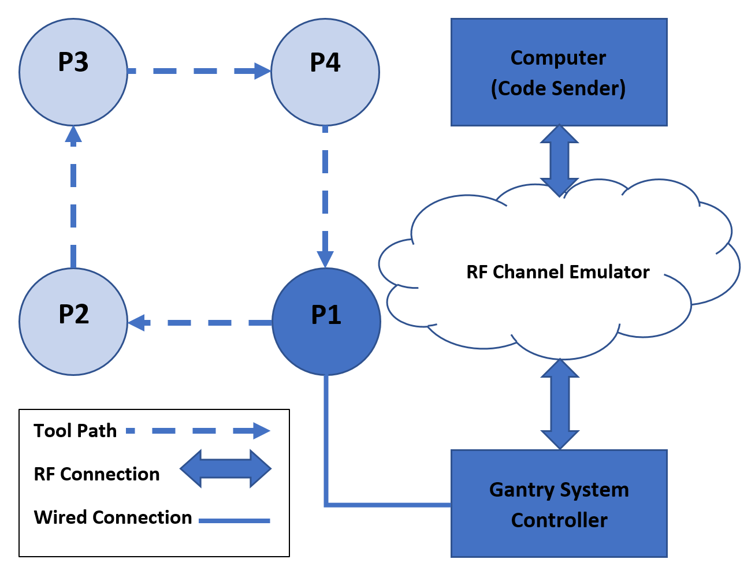
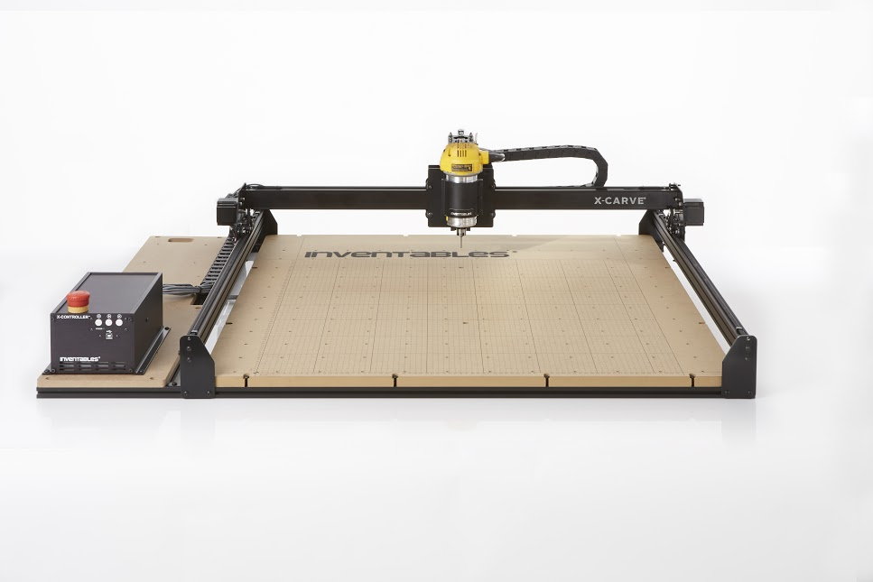
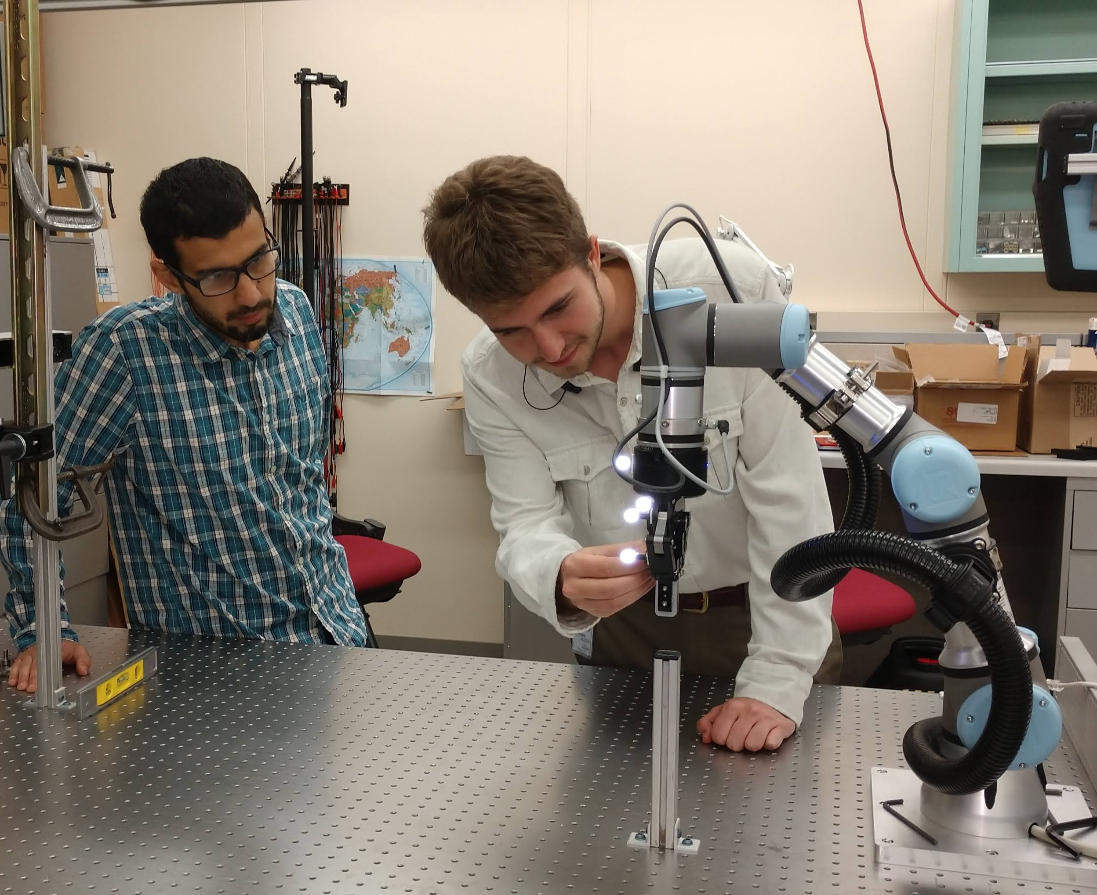
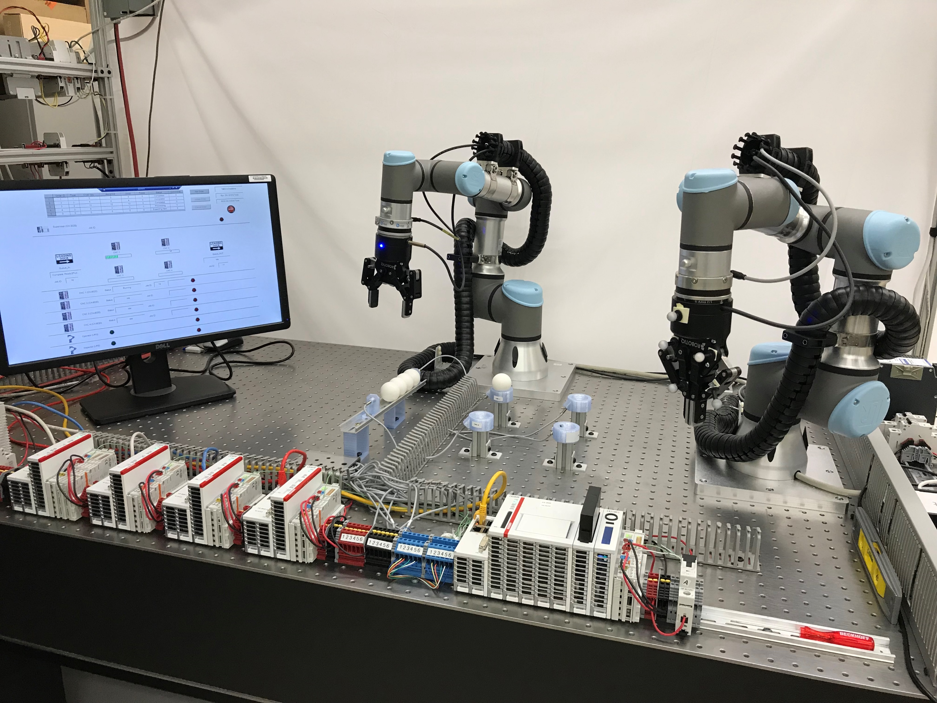
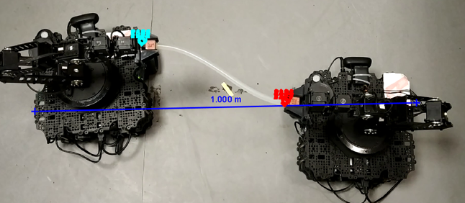
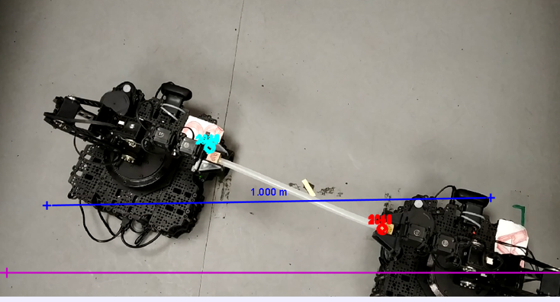
Past Testbed Incarnations
(1)
1 - NIST - Tennessee Eastman chemical plant simulator
2 - NIST - 3D gantry system
3 - NIST - Force seeking apparatus
4 - NIST - Dual-robot machine tending with inspection
5 - Intel Dual-robot tether apparatus using TSN
(3)
(4)
(5)
(2)

Slide 16
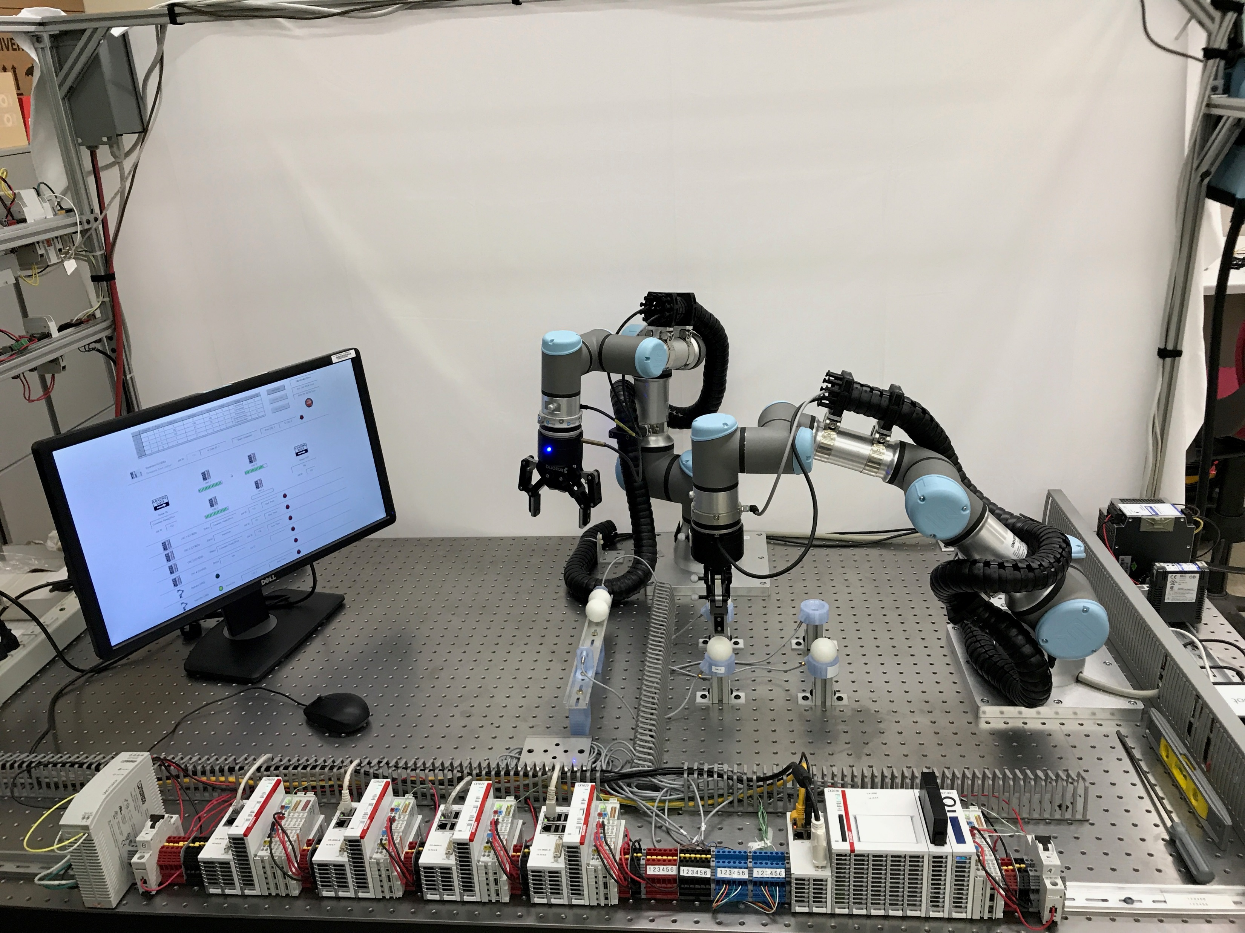
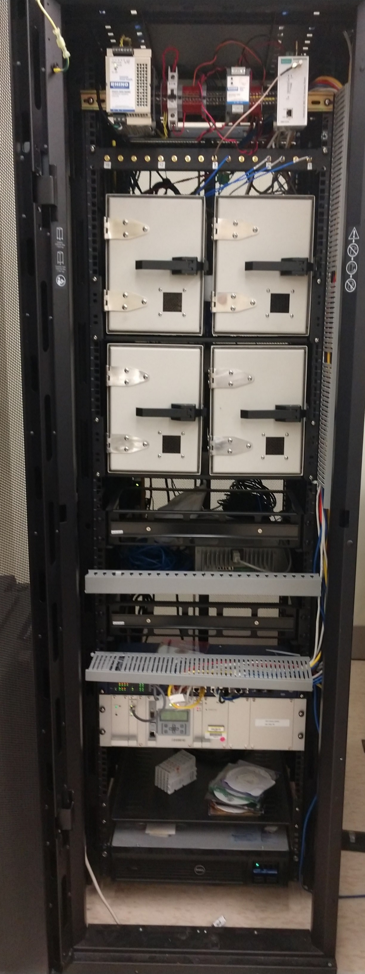
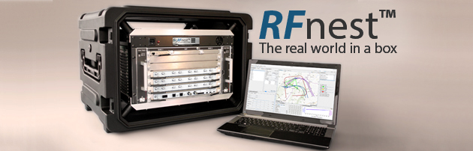
The NIST Industrial Wireless Testbed and Demonstration Platform
Dual Cobots
RF
Shielding
CNC Sims
Supervisor
IEEE 1588 Master
RF Channel Emulator
TSN Capable

Slide 17
Key Capability: RF Channel Emulator
Transmission Delay
Path loss
Multipath
Fading
Interference
Mobility Radios
Mobile Surroundings
Recreates the Factory’s Radio Environment in the Lab

Slide 18
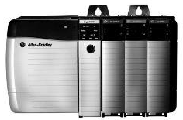
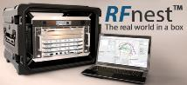

Example: Chemical Reactor Control
Controller
Path Loss
Delays
Multipath
Interference
Actuators
Valve position
ON/OFF
Set-points
Reconfigure
Thresholds
Sensors
Level
Temperature
Pressure
Flow
Composition
Position

Slide 19
Application of the Graph Database to CPS Discovery
Performance Estimation, Testing, and Control of Cyber-Physical Systems Employing Non-Ideal Communications Networks
Richard Candell

Slide 20
Contribution of the GDB Approach
Ultimately, one could argue that the primary contribution of this component of the thesis is to demonstrate the interconnection between the industrial (wireless) network and physical operations through the modeling and capture of the performance data, the data relationships, and the analysis of physical action performance when network performance is degraded. The use of the graph database makes that possible.

Slide 21
Machine Learning in a Robotic Force Seeking Application
Performance Estimation, Testing, and Control of Cyber-Physical Systems Employing Non-Ideal Communications Networks
Richard Candell

Slide 23
Thoughts and Future Direction
Performance Estimation, Testing, and Control of Cyber-Physical Systems Employing Non-Ideal Communications Networks
Richard Candell

